Slide 1
RANSAC

Slide 2
RANSAC
Random sample consensus
It is an iterative method for estimating a mathematical model from a data set that contains outliers.
The RANSAC algorithm works by identifying the outliers in a data set
It estimates the desired model using data that does not contain outliers.

Slide 3
Steps
Randomly selecting a subset of the data set
Fitting a model to the selected subset
Determining the number of outliers
Repeating steps 1-3 for a prescribed number of iterations

Slide 4
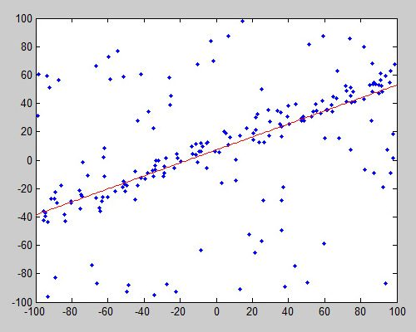
Data points shown in blue, with the line of form y = mx+c estimated using RANSAC indicated in red

Slide 5
In computer vision, RANSAC is used as a robust approach to
1. It estimates the fundamental matrix in stereo vision
2. It finds the commonality between two sets of points for feature-based object detection, and
3. It registers sequential video frames for video stabilization.

Slide 6
Difference of Gaussian (DoG)

Slide 7
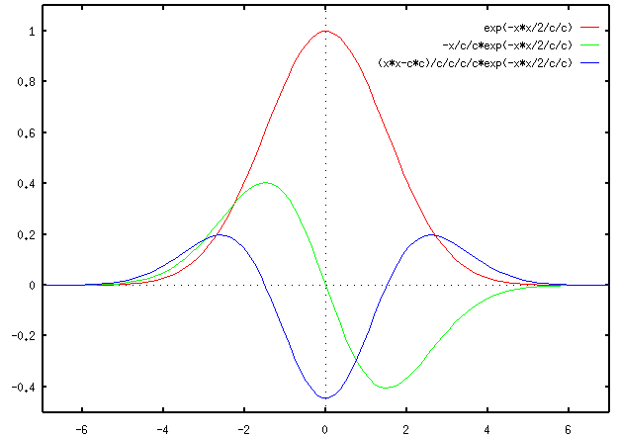
LoG

Slide 8
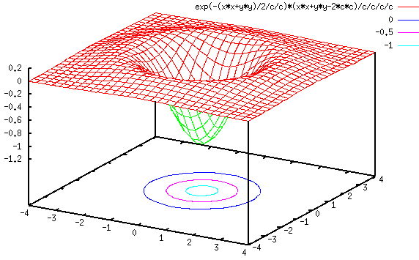

Slide 9
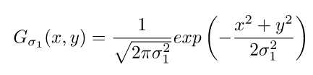
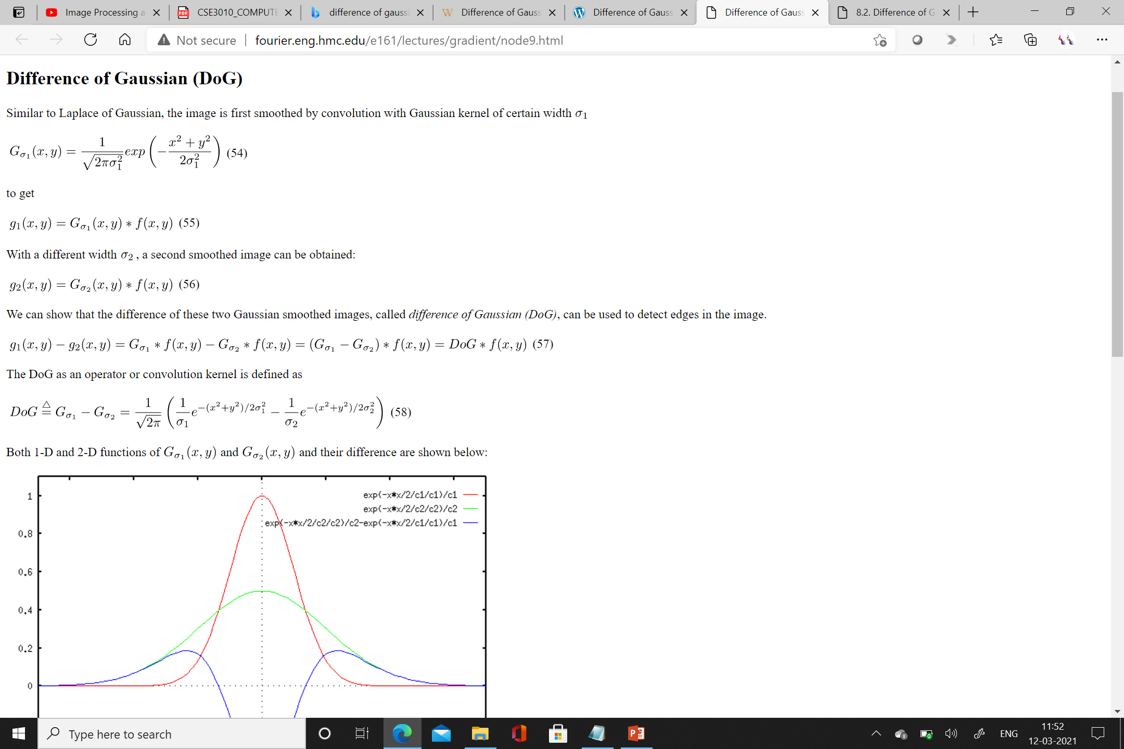
DoG
Similar to LoG, the image is smoothed by convolution with Gaussian kernel of certain sigma value σ₁

Slide 10
Now the image is smoothed by convolution with Gaussian kernel of certain sigma value σ₂
2
2
2
2
2

Slide 12
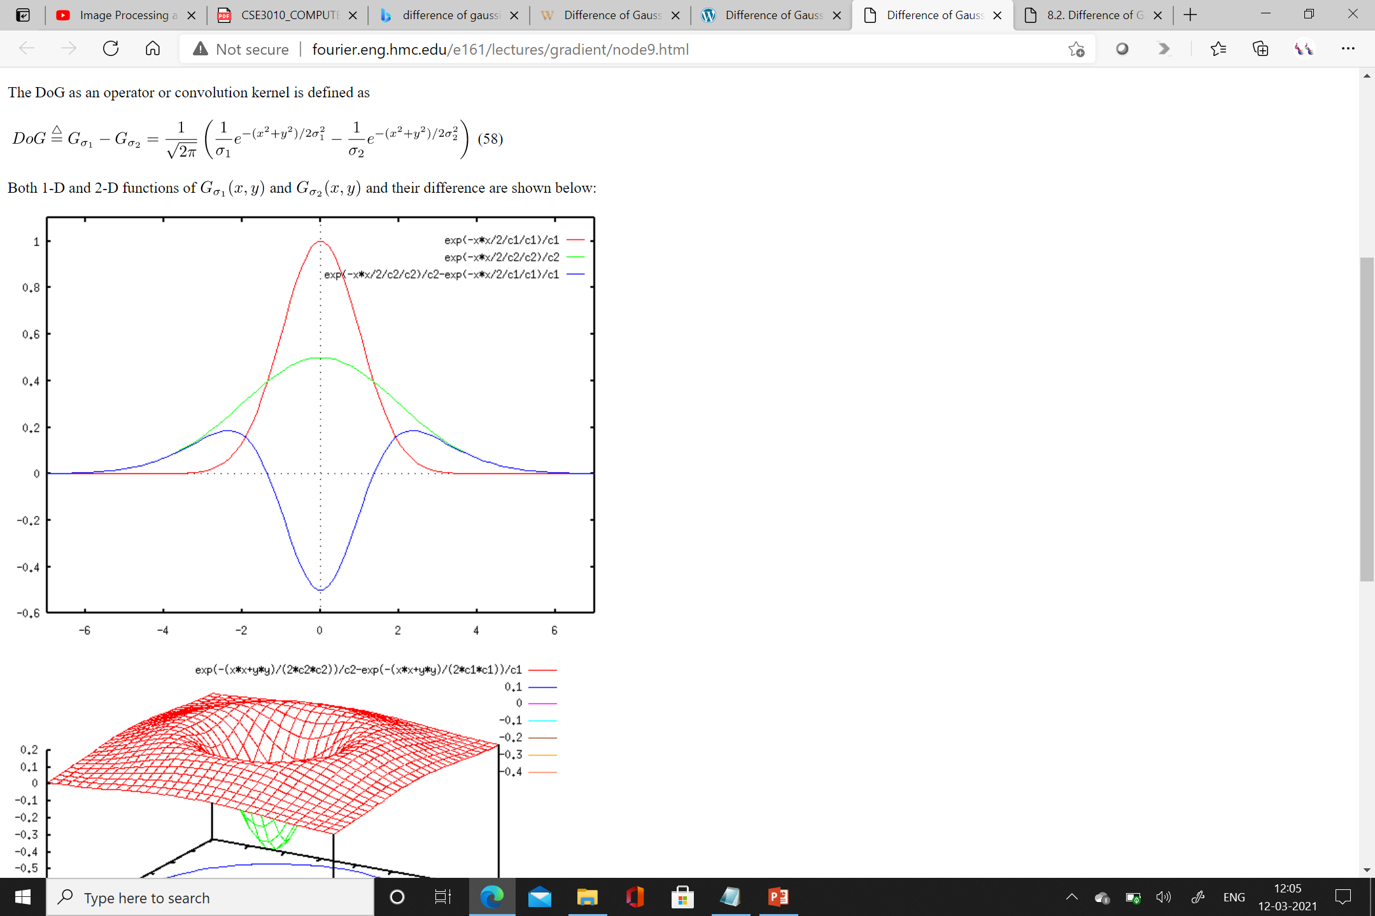

Slide 13
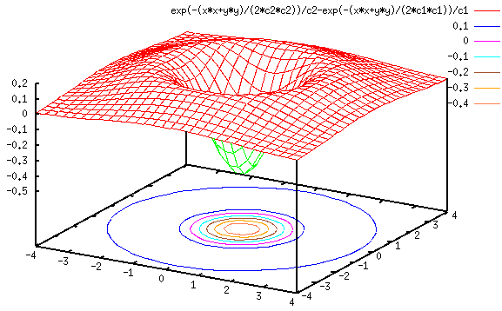

Slide 14
Comparing this plot with the previous one, we see that the DoG curve is very similar to the LoG curve.
Also, similar to the case of LoG, the edges in the image can be obtained by these steps:
Applying DoG to the image
Detection of zero-crossings in the image
Threshold the zero-crossings to keep only those strong ones (large difference between the positive maximum and the negative minimum)
The last step is needed to suppress the weak zero-crossings most likely caused by noise.

Slide 15
Corner Detection
Image segmentation – dividing image in to regions
Done on the similarity principle or on the basis of discontinuities
Corner – important feature
Landmark points
Formed at boundary when two regions meet
Boundary curvature is high
Exhibits large variations in all directions
Edges – variations in only one direction

Slide 16
Known as interest points
Human visual system quickly identifies the corner points
Applications: live tracking, measurement systems, stereo imaging

Slide 17
Moravec Corner detector
Traditional
Calculates edge strength in all directions
Minimum is selected
Compared with the threshold
Non maximal suppression is applied
Extract set of corner points

Slide 18
Limitations
Not rotationally invariant
Sensitive to small variations

Slide 19
Harris corner detector
Popular corner detection algorithm
Uses autocorrelation function – find score with respect to direction
Small square window is placed around each pixel
Window is shifted in all 8 directions
Auto correlation is performed
No variation – region is a patch
Large variation – marked as interest point

Slide 20
Consider (x,y) as point
Shifting of window (dx,dy)
Corner score – c(x,y)
C(x,y)=Image function – shifted image
Shifted image can be approximated by taylor expansion

